Slide 1
Meeting 03/24/2020
Naudé Conradie
19673418

Slide 2
Theoretical Work
Code
Write results to .txt file
Displacement in x and y directions
Global stress
Total strain
Look at L-systems next
Closed boundary
No free elements

Slide 3
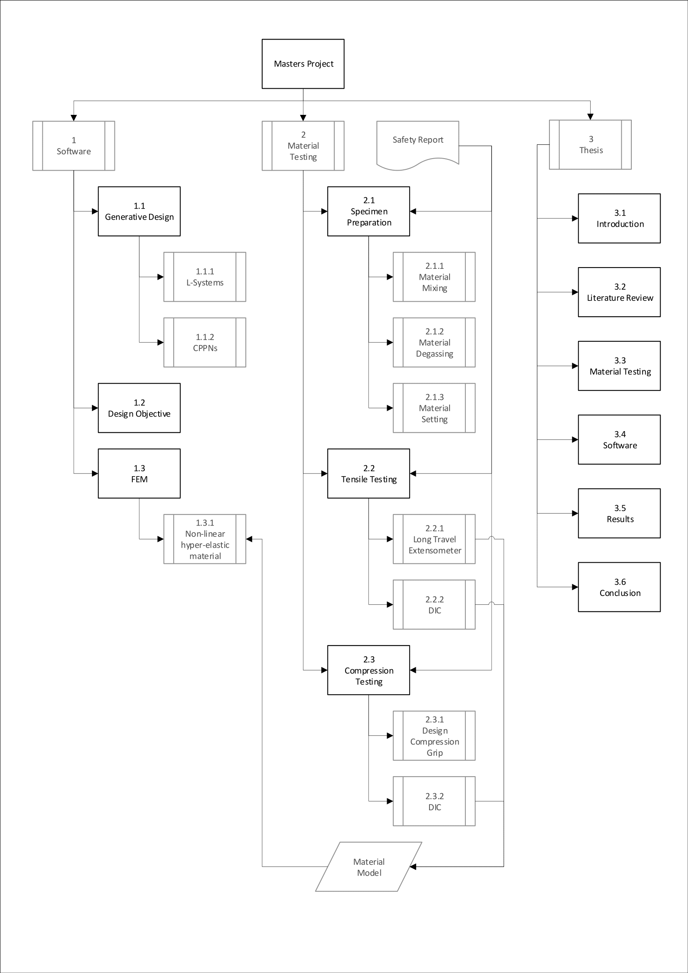
Work Breakdown Structure

Slide 4
Practical Work
Drawings
Sign off
Deliver to Mr. Ferdi Zietsman
Find out if can be done
Lockdown

Slide 5
General Admin
Remote desktop set up
Loadshedding & lockdown
Next quarterly report

